Slide 1

Test taking tips and study skills
Jason Haskins, MS
ILC Tutor
Wake Tech Community College

Slide 2

Time Management
Plan your study time
Arrive early on test day
Don’t procrastinate/cram

Slide 3
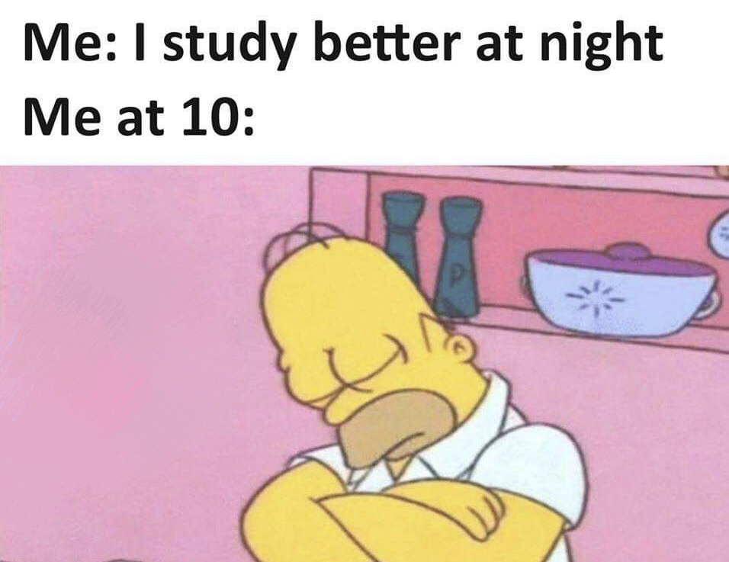
Study habits
Stay healthy
Sleep
Stay hydrated

Slide 4
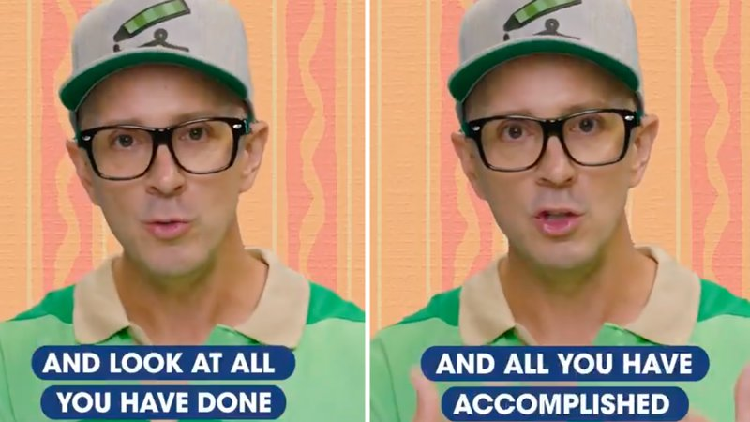
Test Taking skills
Watch for clues
Prepare an outline
Use visual aids

Slide 5
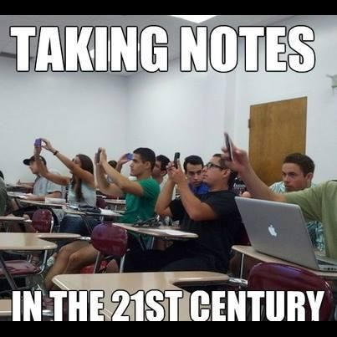
Note Taking
Use a note taking method
Actively listen
Be prepared
Review notes after class

Slide 6
Synthesizing Information
Active Learning
Put in own words
Teach it to someone else
Mnemonics

Slide 7
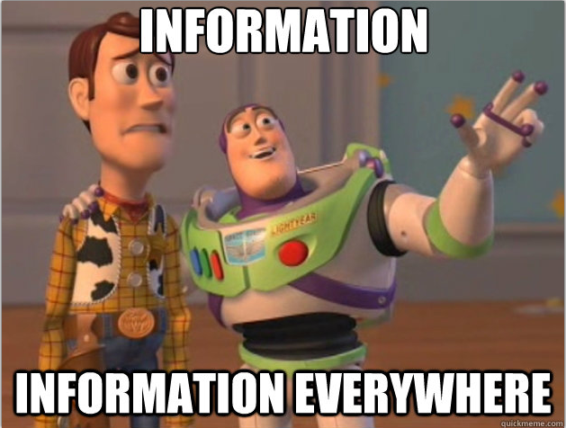
Resources
Use your instructor
Review with a study group
ILC at Wake Tech

Slide 8
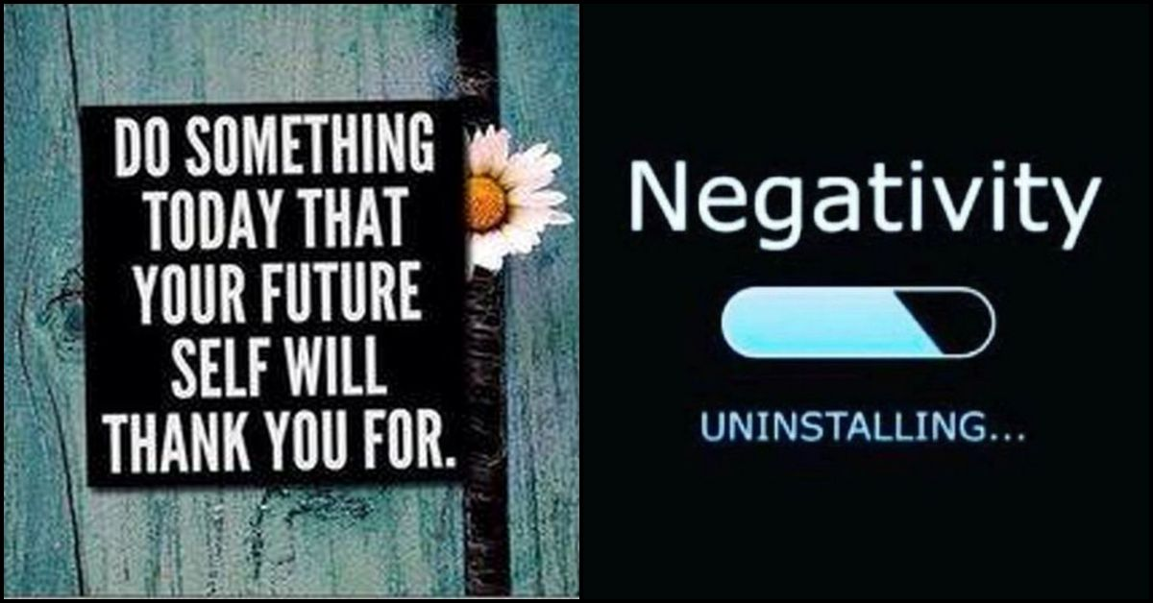
Positive Thinking
Be confident
Rely on first impressions

Slide 9

Questions??

